Slide 1




A Time-Frequency Representation of Gravitational Waves
Jaxson Mitchell
Acknowledgements
Mentor: Dr. Cameron L. Williams (Department of Mathematics)

Slide 2

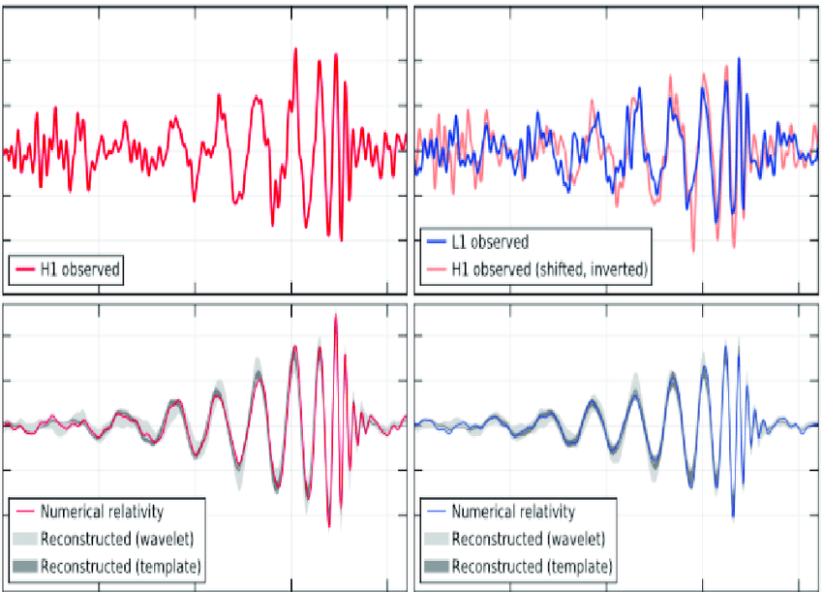
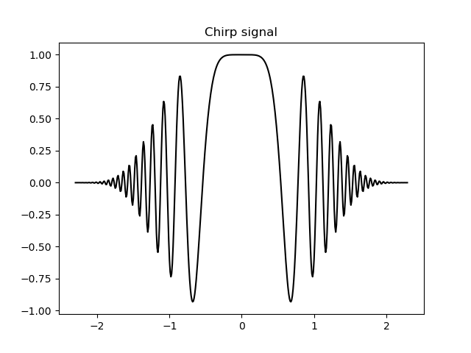
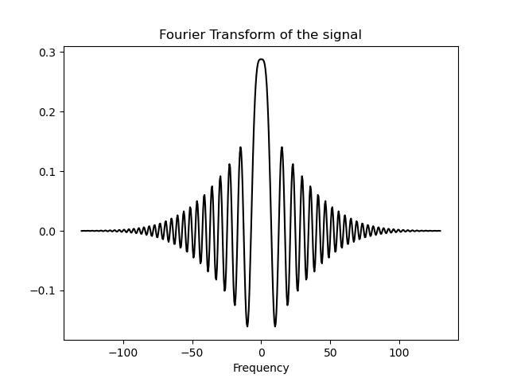
What are chirps?
Chirp- A signal whose frequency changes with time
The Fourier transform of a chirp.
Gravitational waves (a chirp signal)
The discovery of gravitational waves: a gentle fight against noise - Scientific Figure on ResearchGate. Available from: https://www.researchgate.net/figure/Plots-of-the-signal-of-the-first-gravitational-wave-direct-detection-On-the-top-left_fig1_319196709 [accessed 6 Apr, 2023]
Goals of this research
  Implement a discrete method for analyzing chirps
  Extract chirps from gravitational waves
An example of a chirp signal with chirp order n = 3
Fourier transform of the chirp signal.

Slide 3
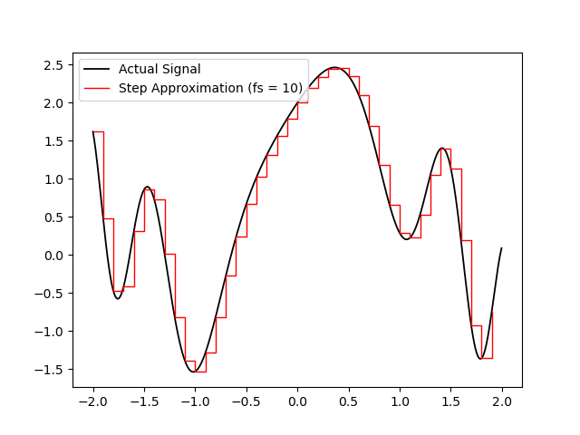
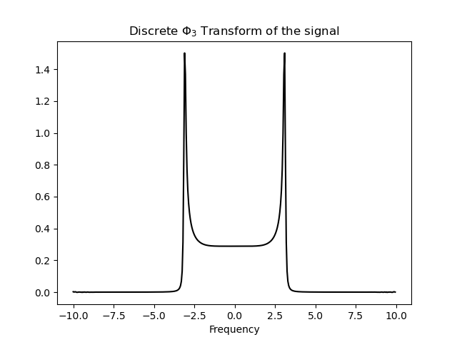
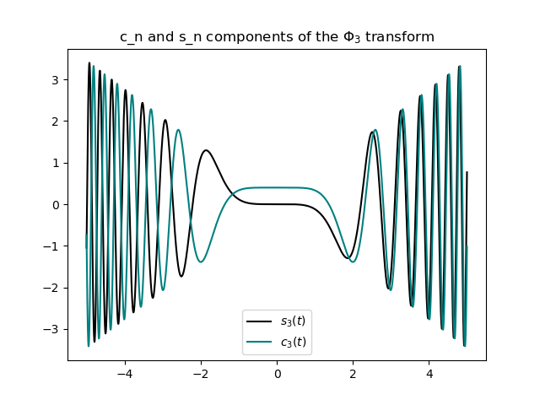
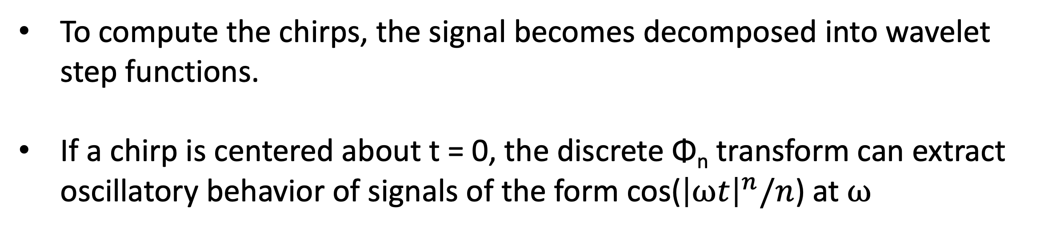
The discrete Φ_{n} transform
To compute the chirps, the signal becomes decomposed into wavelet step functions.
If a chirp is centered about t = 0, the discrete Φ_{n} transform can extract oscillatory behavior of signals of the form cos(${\left|⍵t\right|}^{n}/n$) at $⍵$
Step function of a signal with 30 steps per second
The software’s dpt function
The same chirp signal as before
The 3-frequency data of the chirp
Components of the transform

Slide 4
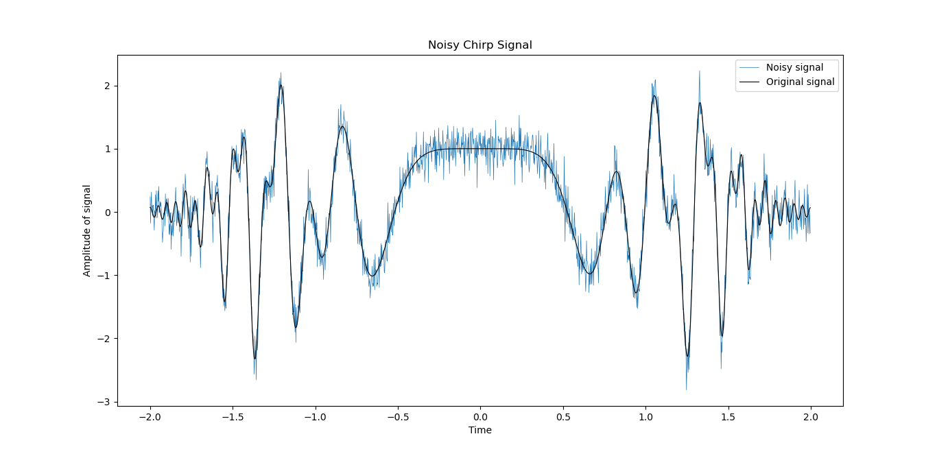
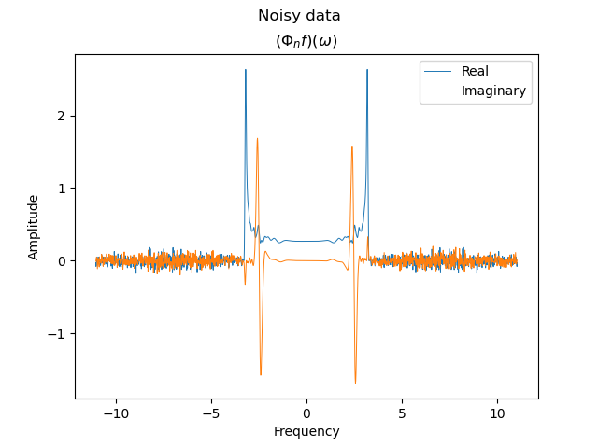
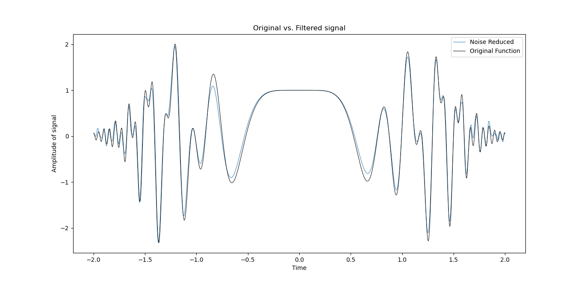
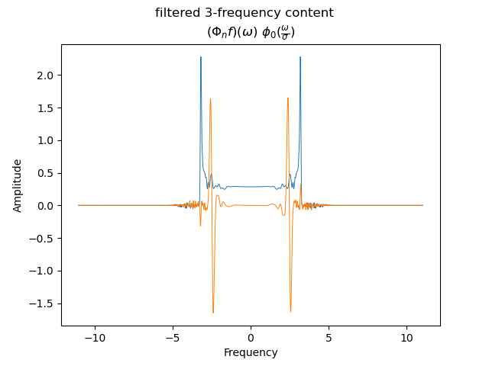
Gaussian noise filtration
Pure signal and noisy signal with a standard deviation of σ = 0.3
3-frequency data of the signal
Chirp signals can filter out white noise using this software.
Pure signal & filtered noisy signal.
3-frequency filtered data of the signal

Slide 5
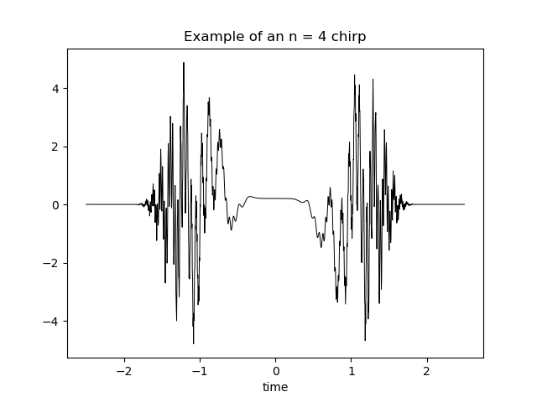
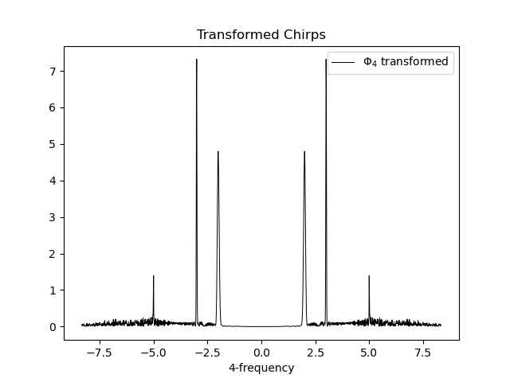
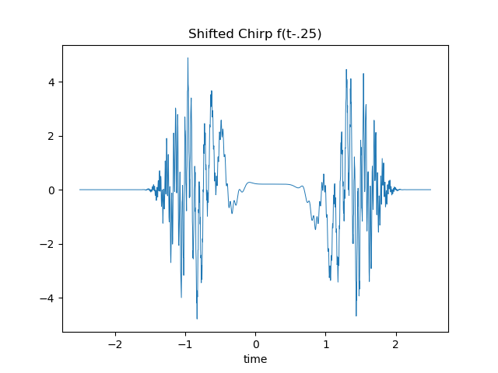
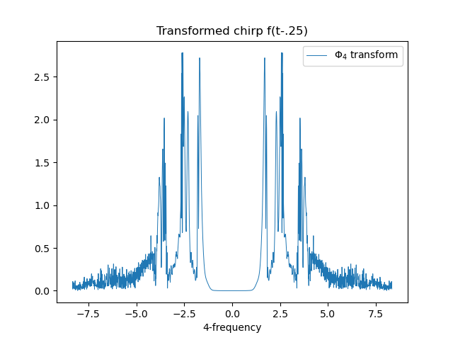
Pitfalls of the Φ_{n} transform
Chirps can be extracted, only if aligned properly.
Φ₄-transform
Translation of a signal by .25 seconds
Φ₄-transform

Slide 6
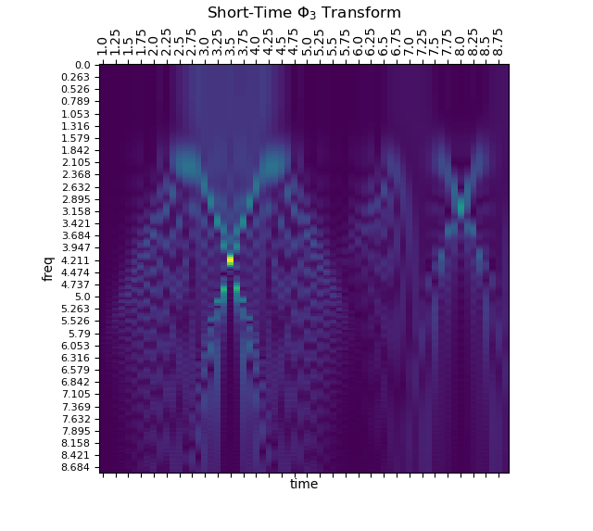
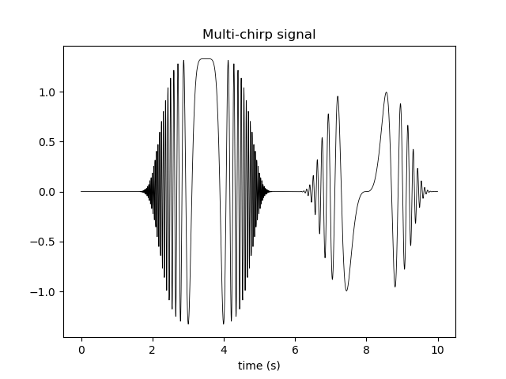
Short-Time Φ_{n} Transform
Instead of one transformation, now taking small time steps and a transformation for each one gives a new time frequency representation of a signal.
Short-time transform of a multi-chirp signal. The local peaks at the intersections correspond to the chirp frequencies and times.
Two chirps of order 3 centered around t = 3.5 & 8 seconds.

Slide 7
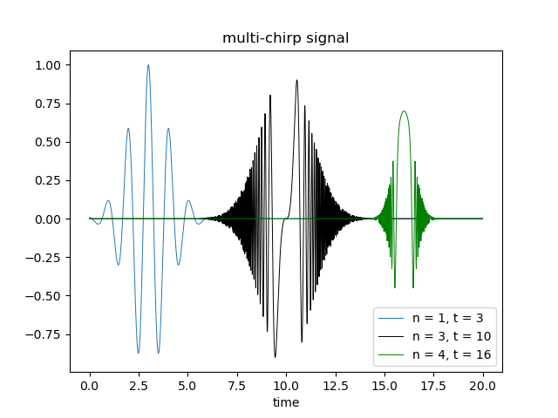
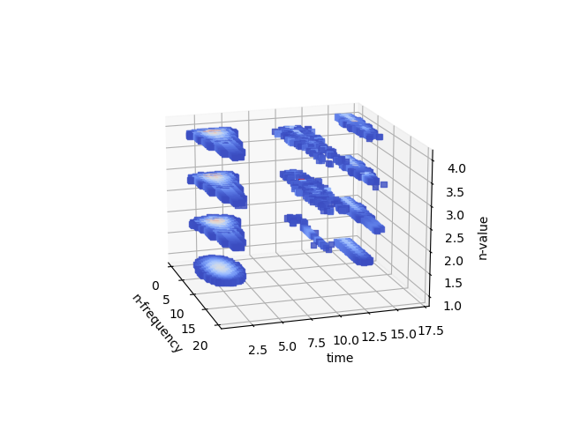
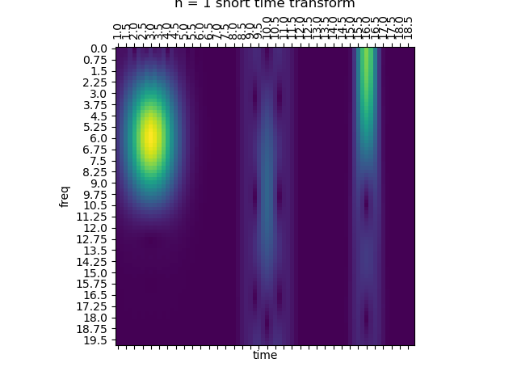
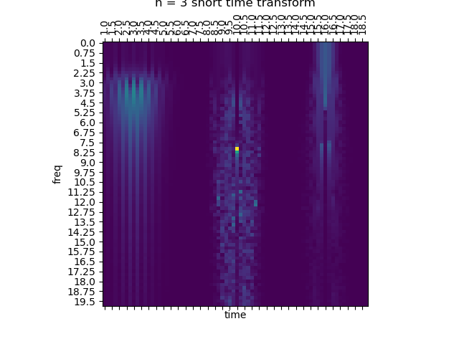
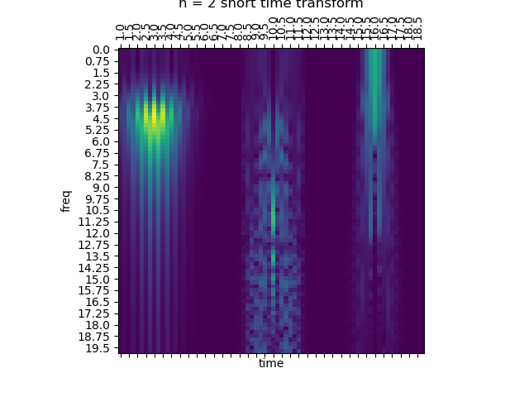
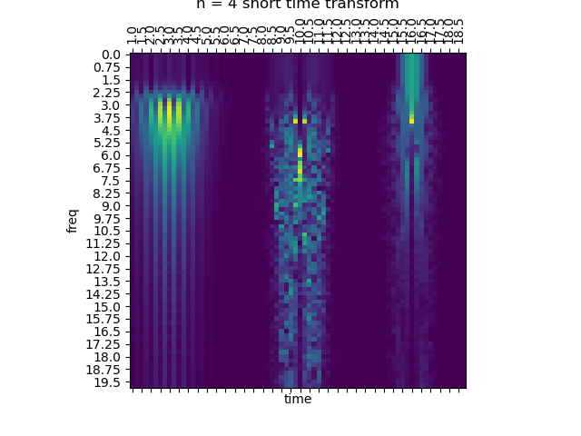
Voxel representations
Applying the short time transform over a range of chirp orders gives a three-dimensional representation of data.
To visualize it, a voxel plot is used which can give an idea of the maximum frequencies.
Three signals of varying chirp order creating a signal.
Voxel representation of the signal. The maximum can be seen at t = 10, n = 3.
n = 1, 2, 3, 4 short time transforms which make up the voxel representation

Slide 8
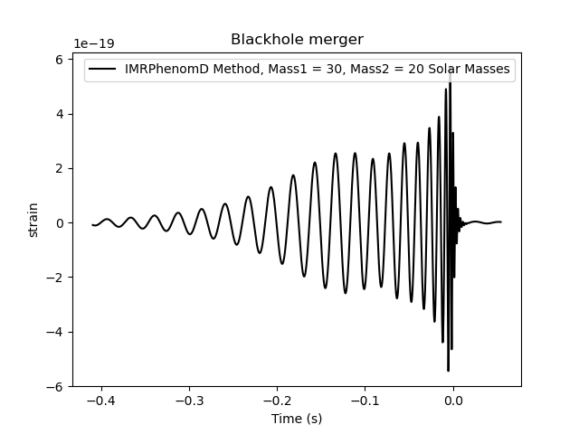
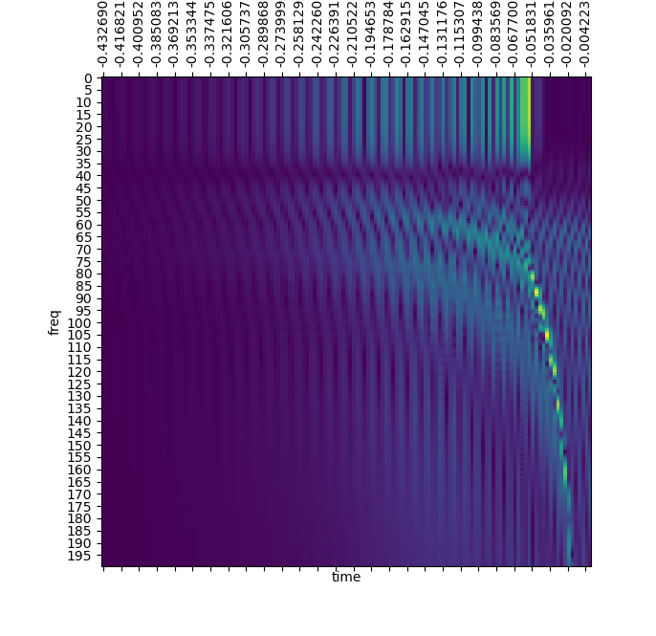
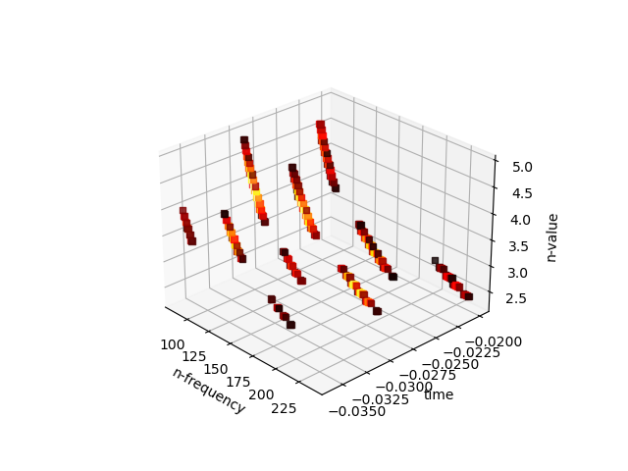
Application to GWs
The software can be applied to extract chirp data from gravitational waves using the voxel representation.
Generated gravitational wave signal
n=4 short-time transform
Voxel representation of a gravitational wave. Threshold = .7

Slide 9
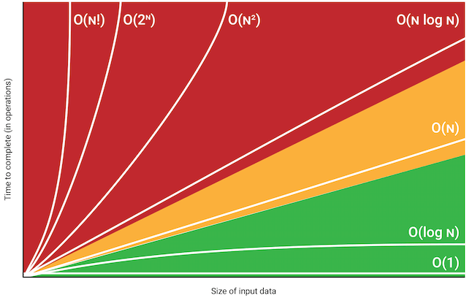
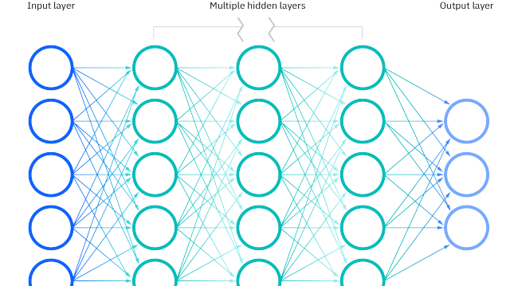
Future Research
Use a super computer to generate and analyze a large number of analytical gravitational waves.
Study different types of noise within signals
Study different types of chirp signals (seismic)
Optimize the code
The major content of the gravitational wave will be put into a neural network to try to fit for its physical parameters such as the mass.
O-notation plot, dpt is O(n^2)
https://pub.towardsai.net/big-o-notation-what-is-it-69cfd9d5f6b8

